Slide 1
Structural Optimisation Using Statistical Inference Techniques
Zoe Tan
Notes:
the aims of the project and their significance;
the background and context;
your plan of how to achieve the aims;
the progress made so far towards fulfilling the plans.
WHY? – want to get best product for least cost (money and time)

Slide 2
Structural Optimisation
Save material and cost in building final product
Structural optimization can be seen as a (constrained) multi-variate minimisation of a “black-box” function
Behaviour of a structure can be modelled using Finite Element Models
Imperfect models (and prototypes) mean data is noisy
Take noisy data points, estimate overall distribution and find the minimum point
Is there a data driven approach?
Notes:
Have FEM, engineering models, hand made models – things are non-linear/intractable can’t just take derivatives (convention)
Data-driven approach instead of just taking derivatives

Slide 3
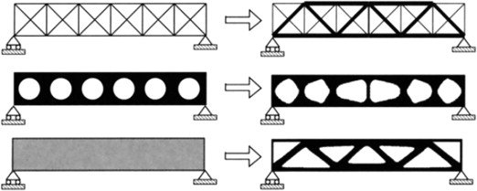
Size optimisation – vary radii of members in truss
Shape optimisation – vary lengths/angles of polygons or shape type
Topology optimisation – vary layout of material in predefined space
Notes:
Scope of project limited to parameter optimisation, which can include all 3 types seen here but the problems would need to be parameterised.
size optimisation easy to see, make variables the radius of each beam in the truss
shape optimisation more difficult, can define continuous variables e.g. lengths and angles of polygons or discrete variables e.g. a finite selection of shapes (star, rectangle, oval etc.)
Topology optimisation (material layout within predefined space) even more difficult to parameterise, no predefined configuration but can probably be done (thickness of each finite element)

Slide 4
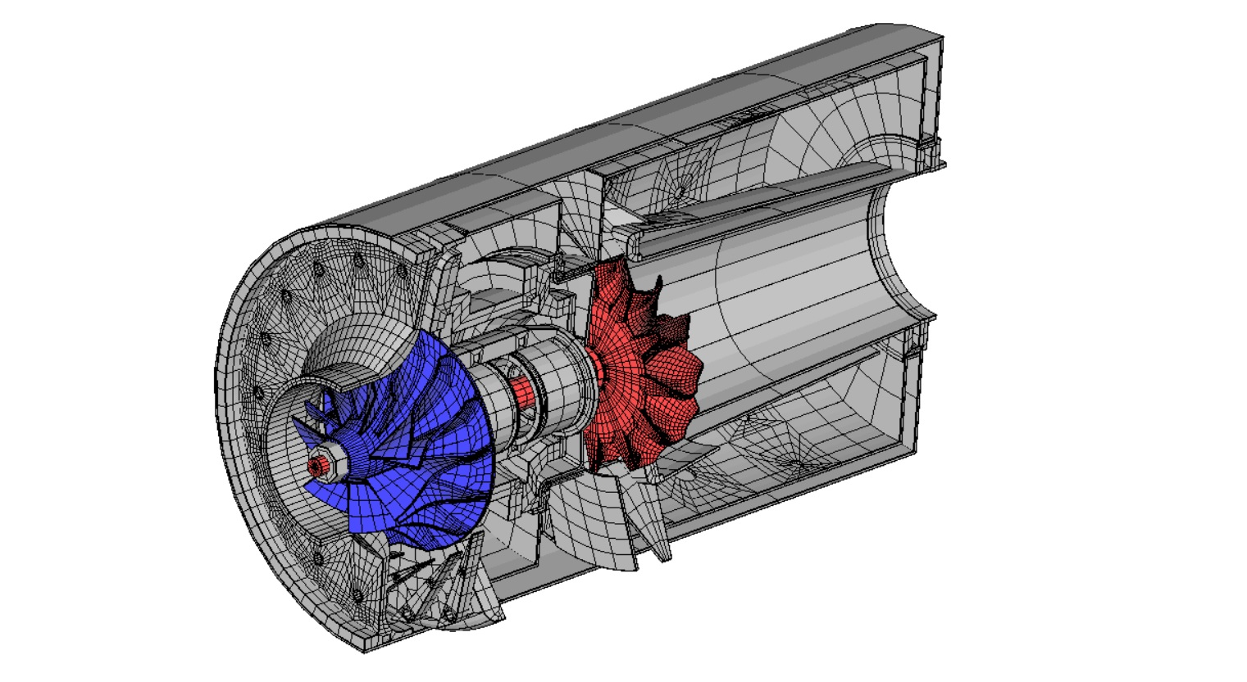
Notes:
Finite element model example – 5 years time
Jet engine model – can use this technique to find optimal angle/shape of turbine fins, minimising material weight and keeping stresses within some limits
Takes long time to compute – order of an hour
Can’t do trial and error - can we take data driven approach

Slide 5
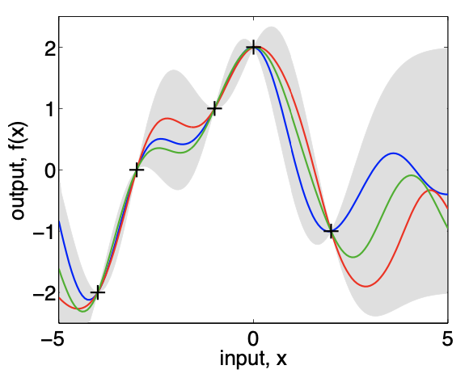
Gaussian Processes
Multivariate Gaussian distribution with infinitely many variables – models functions
Defined by a mean function and a covariance function
Bayesian – p(y|x)=p(x|y)p(y)/p(x)
Incorporate acquisition functions to efficiently find new data points of interest
Notes:
Basic explanation of Gaussian Process – like a gaussian distribution but for functions
Mean function pretty self explanatory
Covariance function defines covariance between points some distance apart – how form of function and characteristics like wiggiliness
Bayesian optimisation part - Acquisition function balances exploration and exploitation
Here only showing 1D – much more complicated in higher dimensions

Slide 6
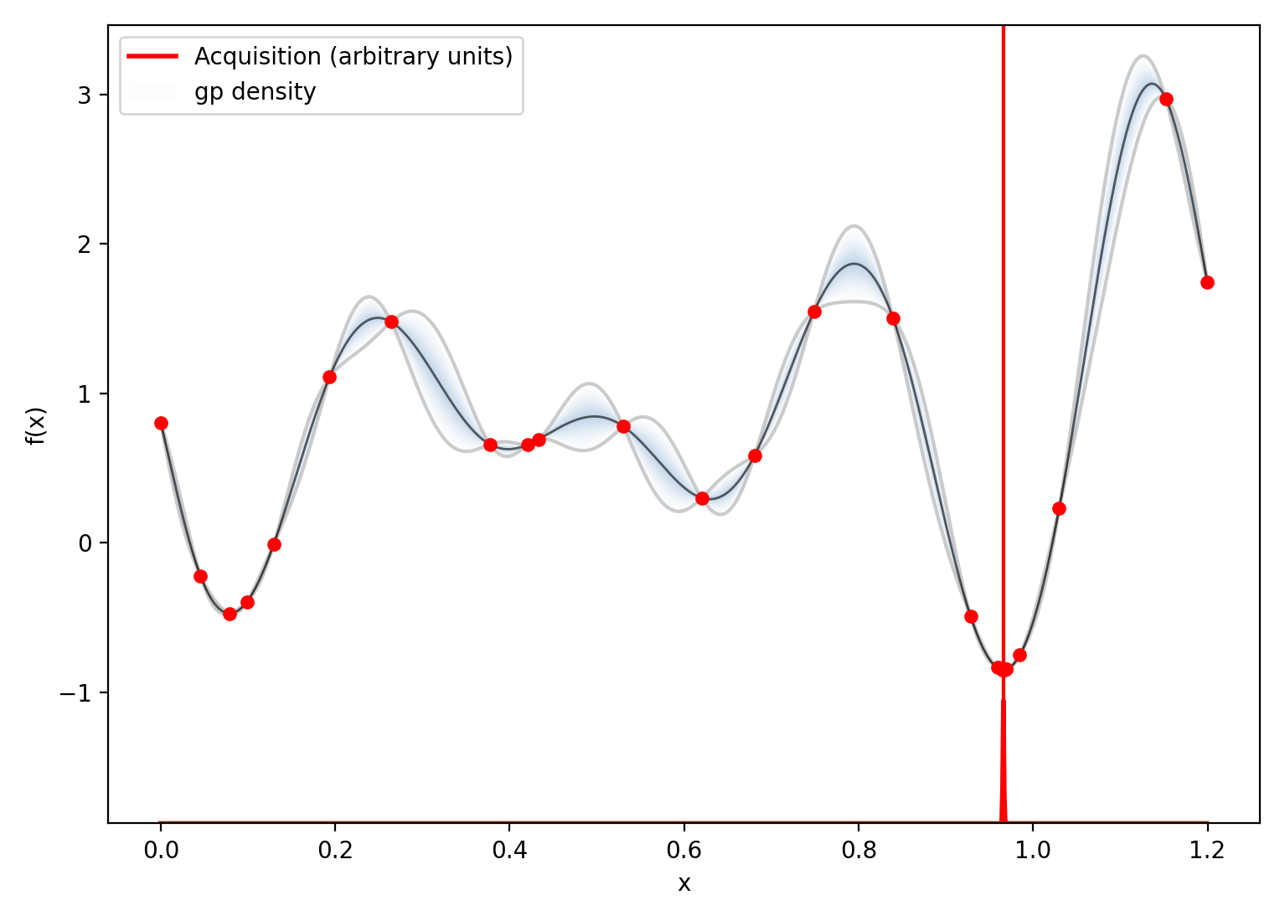
Notes:
GP optimisation testing that I did

Slide 7
Notes:
Animation of acquisition function use

Slide 8
improving the Optimisation
Difficulties
Solutions
Gaussian Process posterior (and predictive distribution) has a term which requires calculating [K(x,x)+σ_{noise} I]⁻¹
O(N³) calculation
Optimisation takes long time if lots of high dim data points
FEM models can take very long to run, difficult to get lots/enough data points to fit GP
Sparse GP
Summarise large dataset with a smaller number of pseudo-data
Reduce complexity to O(N²M)
Multi-fidelity GP
Take many samples from cheap to evaluate f₁(x) and few samples from expensive f₂(x)
Combined training and prediction to get better estimation of high-fidelity f₂(x)
Notes:
Posterior of the Gaussian process
calculating each point takes very long time when FEM models complex and large
Sparse GP:
Can optimise for where these pseudo-data are to get best approximate posterior distribution
Multi-fidelity GP:
Low fidelity GP model, related high fidelity GP model, combine training – joint GP distributions
Estimate structure with beams, coarser FEM meshes etc. to do faster calcs
Different approaches to handle high-dimensional space, large calculations

Slide 9
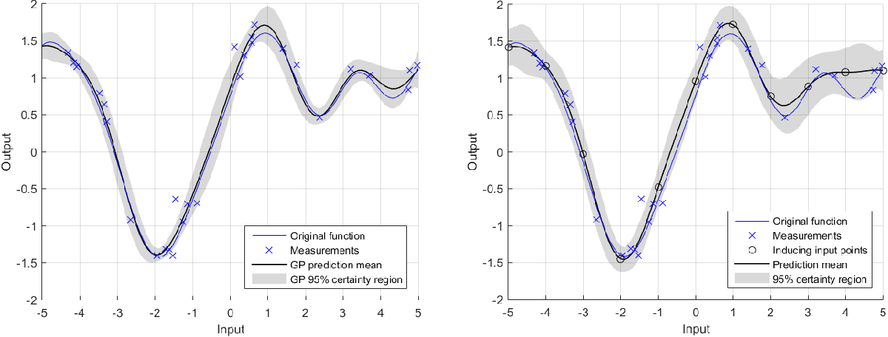
Notes:
Sparse GP

Slide 10
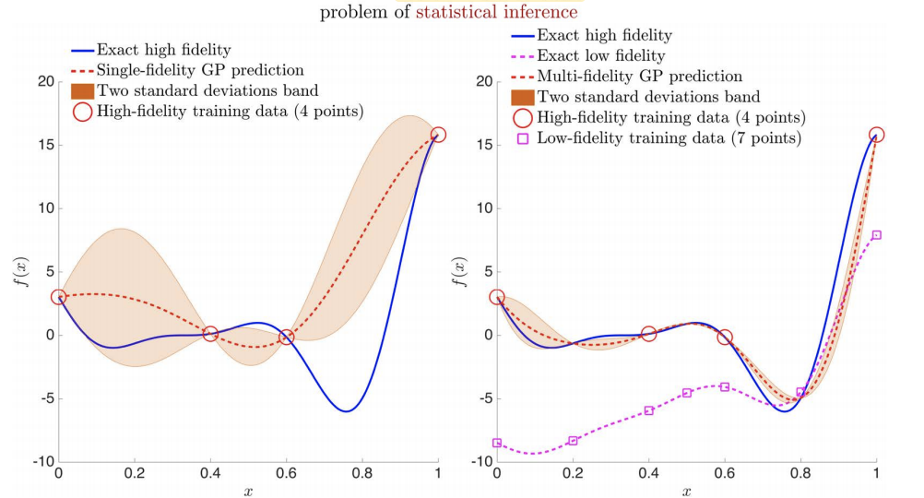
Notes:
Multi-fidelity GP example
- Still investigating this, but we seem to have to consider the ratio of data points between HF and LF, and could potentially be confidently wrong in the prediction

Slide 11
Plan
Explore basic Bayesian Optimisation using Gaussian Process models
Progressed
Coded in Python using GPyOpt library basic functionality and low and high dimensional functions with known optimums
Find bottlenecks in the optimisation process and explore how these can be reduced
Sparse GP progressed, multi-fidelity GP progressing
Apply GP model optimisation on simple structural problems – connect GP and FEM of beams and cantilevers
Progressing
Next term: Application on more complex structural problems
Notes:
Aim: explore how Bayesian optimisation can be applied on structural optimisation problems using Gaussian Process models trained on FEM data.
Some conclusions so far – non-convex functions get much bigger errors (but this is to be expected, more local minima to get stuck in)
Sparse GP good for when initially given lots of data points
Obtaining data points is probably most time consuming part – apply multi-fidelity gp instead

